Slide 1
Protein Signature and Classifier Discovery: The Forest Through the Trees
CWRU Data Science Bootcamp
Frankie Wong, Ben Snyder, Debra Fenty, Chris Bock

Slide 2
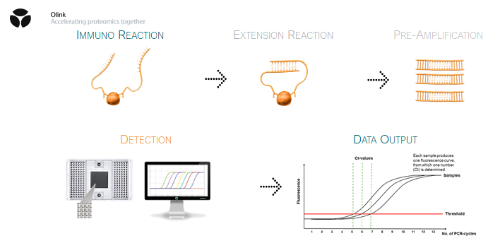
Introduction to Olink Data
Measures >1000 proteins in a human plasma or serum sample
Data are reported in a relative protein concentration unit called NPX
Looking for significant changes in protein levels (up or down regulated) within a clinical patient population
Notes:
Chris

Slide 3
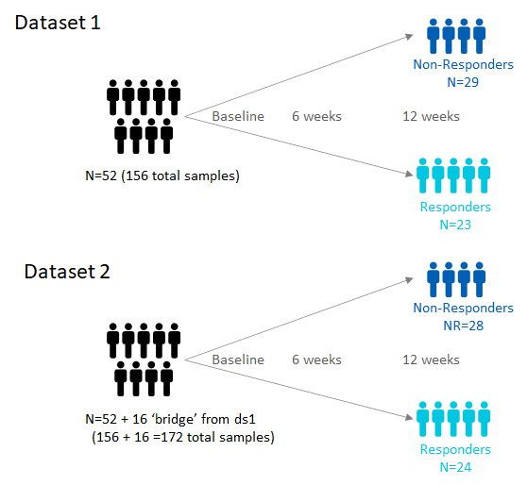
Dataset Metrics
Clinical variables:
Response status (Responder or Non-responder)
3 timepoints (Baseline; Week 6; Week 12)
Lab where sample was drawn (Sites A-E)
1104 protein measurements

Slide 4

Project Scope
Use Random Forest to find a classifier for response
Test and train on Dataset1
Does the model give favorable results testing on Dataset2?
Identify what factors have significant effects on protein expression
Time points
Site-to-site variations
Batch-to-batch variations
Notes:
Debra

Slide 5





Tools and Libraries Used
Pandas
Matplotlib
Seaborn
NumPy
Statsmodels
Ordinary Least Squares (OLS)
ANOVA
Sklearn
Random Forest Classifier Model
JavaScript/HTML
Bootstrap/CSS
Plotly
BeautifulSoup
Notes:
Debra

Slide 6
Data Cleaning
4 total Excel files were provided
One data and annotation file per dataset
Data were merged and cleaned in pandas
Multi-line header concatenated to create a unique identifier:
‘Assay’ (protein name) + ‘OlinkID’ (unique OlinkID)
‘UniProt ID’ (universal protein identification number) was removed for later
Remove:
Limit of detection (LOD) metrics
Panel metadata
Extra data file information and QC metrics
Notes:
Frankie

Slide 7
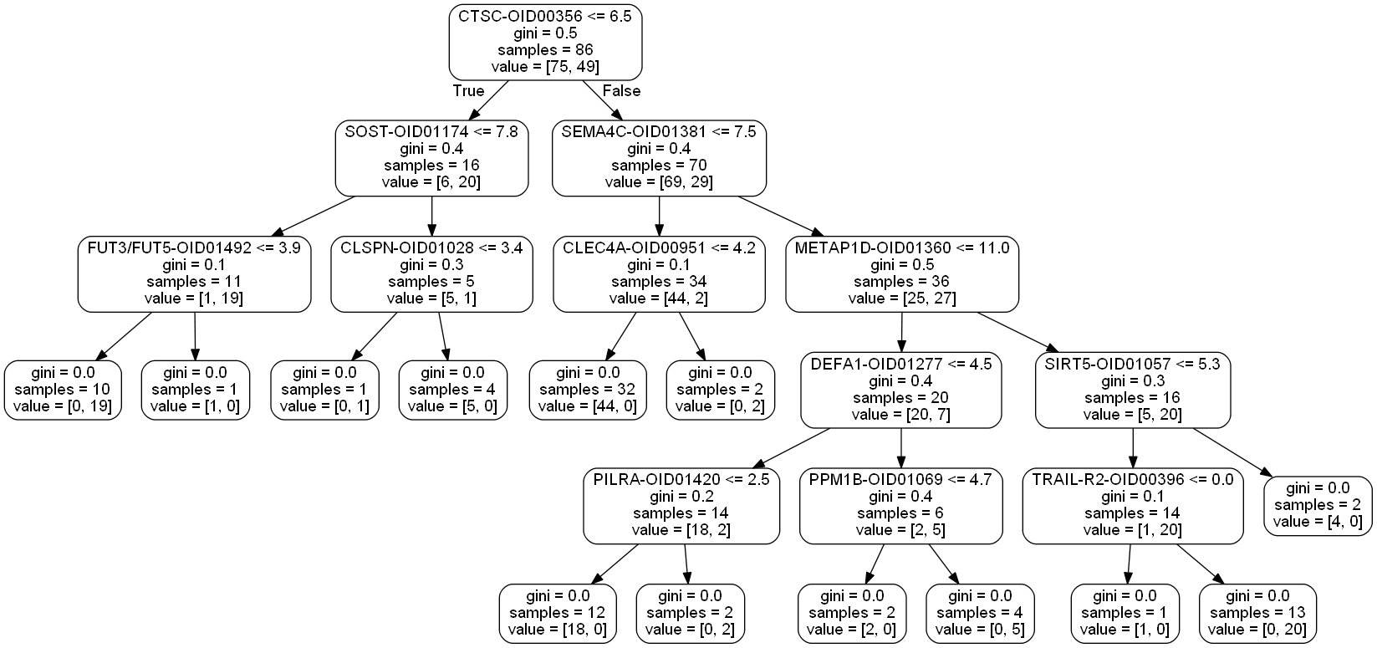
Machine Learning: Random Forest
Quick and accurate classification model
We sought out to predict whether a sample is a “Responder” or “Non-Responder” based on Protein NPX levels, Site, and Time
Trained with 80% of the data, tested with 20%
Used a forest of 1000 decision trees
Ranked features by importance
Tested on entire second dataset
Notes:
Ben
Used hot encoding to break down the categorical data to binary
Final model used a forest of 1000 decision trees

Slide 8
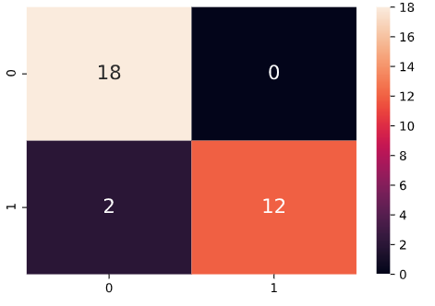
Machine Learning: Random Forest
Test 1
Number of Estimators: 2000
Train/Test ratio: 80/20
F1-Score: .846
Test 2
Number of Estimators: 2000
Train/Test ratio: 80/20
F1-Score: .6363
Test 3
Number of Estimators: 1000
Train/Test Ratio: 80/20
F1-Score: .956
Test 4
Number of Estimators: 1000
Train/Test Ratio: 80/20 with stratified outcomes
F-1 Score: .923
Actual Values
Predicted Values
Notes:
Ben
Didn’t want to over train the model
Trained models using different random states
Test 3 and 4 using the same random state; test 4 uses stratified outcomes to equally allocate the responder/nonresponder labels to the training and testing data because there were 29 nonresponder samples and 29 responder samples
Classification matrix. Bottom axis is the predicted values, top axis is the actual values. Our model correctly predicted 30 of 32 samples

Slide 9
Webpage/Results
https://chrisbock76.github.io/Final_Project/
Notes:
Frankie

Slide 10
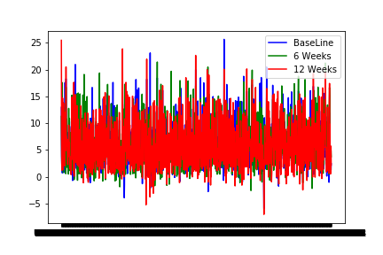
Challenges
How to start breaking down the data
How to visualize the data to find patterns or groups
ANOVA one-way vs. two-way
Deciphering the best machine learning algorithm
KMeans means a mess
Updating the data from ‘Treatment’ to ‘Response’
Random forest regression vs. classifier
Notes:
Ben
Initially we wanted to plot out the data to see if there were any visible outliers or trend lines between the different timeframes and response variables
We had trouble trying to decipher the data using scatter plots. With over 1000 proteins and 156 samples, it wasn’t easy to see anything meaningful. Eventually we turned to box plots which better shows the data
We used ANOVA testing on the data to see statistical significance of certain proteins. We wanted to

Slide 11
Conclusions
The datasets were not scaled or normalized together, showing “batch-to-batch” variation in the random forest model
Test accuracy (ds1, n=32): 0.9375
Test accuracy (ds2, n=156): 0.7051
Large feature number lead to lower importance values for individual proteins
Significant (p < 0.05) changes in populations:
Responders (n=80 targets)
Non-Responders (n=16)
Site (n=72)
Notes:
Chris

Slide 12
Next Steps for Demo Days
Bridge the data using median centering
16 ‘bridge’ samples run on both datasets
Run Benjamini-Hochberg False Discovery Rate (FDR) adjustments on ANOVAs
Analyze significant Site markers (p<0.05, n=72) to ensure real biology is being evaluated in the Responder patient population
Update webpage with ANOVA data tables and a Random Forest page
Notes:
Chris

